Slide 1
Design Concepts
Route Reconnaissance Swarming Behavior
Image Analysis
Radiation Detection Swarming Behavior
Radiation Detectors
Quick-Launcher Design
Notes:
- Add intro. Slides in between each, just like the repeating agendas
- ALL OF THESE SLIDES NEED TO BE RE-ORDERERD AND RE-NUMBERED

Slide 2
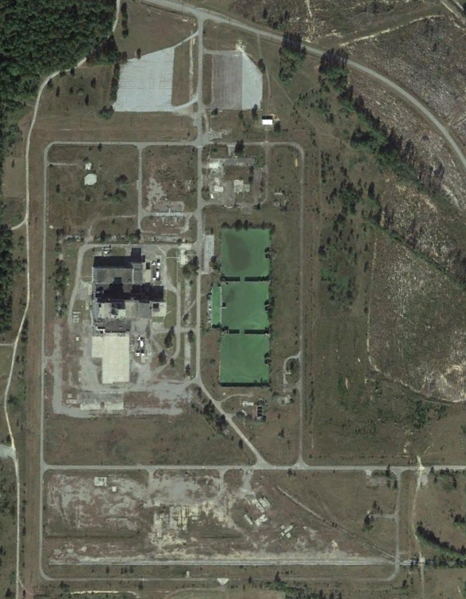
I. Swarming Behavior:
Route Reconnaissance
Goal: Use a swarm of drones to detect obstacles on a road network
Route Distribution:
Create route plan
Decide which drones move to which waypoints
Drone Behavior:
Individual drone behavior given a route plan
Communication between all drones
Savannah River National Laboratory

Slide 3
I. Swarming Behavior: Route Distribution Algorithm
Objectives
Efficient
Optimal
Quick to Implement
Constraints
Complete
Generate Sequence of Waypoints
Evaluation Criteria
Optimality
Time Complexity
Space Complexity
Greedy
Very fast
Very low memory
Quick to develop
Not optimal
Graph Traversal
Fast
Low memory
Not optimal
Constraint Optimization
Fast
Close to optimal
Low memory
Difficult to implement

Slide 4
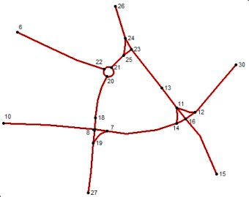
I. Swarming Behavior: Constraint Optimization Problem
I. Swarming Behavior: Constraint Optimization Problem
Model
Constraints
Variable
Cost Function
Solution
Recursive Backtracking
Simulated Annealing
Genetic Algorithm
Road Network
Notes:
Reason algorithm is not specified because familiarity from artificial intelligence course

Slide 5
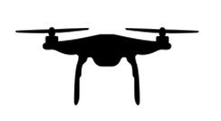
I. Swarming Behavior: Route Reconnaissance Tasks
1
Moves towards waypoint
Takes picture
Sends image for analysis
Receives analyzed data
Sends detailed messages
Reacts to analyzed data
6
2
5
3
4
Notes:
Switch box 5 and 6 he said it was confusing

Slide 6
I. Swarming Behavior: Route Reconnaissance Behavior
Inputs:
T: Time between pictures
R: Road segments
A: Analyzed road segments
P: Drone positions
W: Waypoint sequence
Algorithm:
If initialize:
Plan W with P and R
If we’re at the first waypoint in W:
Remove it from W
Mark segment in A
Send segment analyzed message
If it’s been T time since the last picture:
Take a picture
Send the picture to analysis
If analysis states there is an obstruction:
Send re-plan message
Re-plan W with P and R
If receive re-plan message:
Re-plan W with P and R
If receive segment analyzed message:
Mark segment in A
If receive position update message:
Update drone position in P
Dependencies:
Route Plan Algorithm
Take Picture
Send Picture to Analysis
Send Message
Notes:
Start with initial route... call the pre route mentioned before

Slide 7
Design Concepts
Route Reconnaissance Swarming Behavior
Image Analysis
Radiation Detection Swarming Behavior
Radiation Detectors
Quick-Launcher Design
Notes:
- Add intro. Slides in between each, just like the repeating agendas
- ALL OF THESE SLIDES NEED TO BE RE-ORDERERD AND RE-NUMBERED

Slide 8
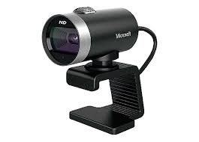
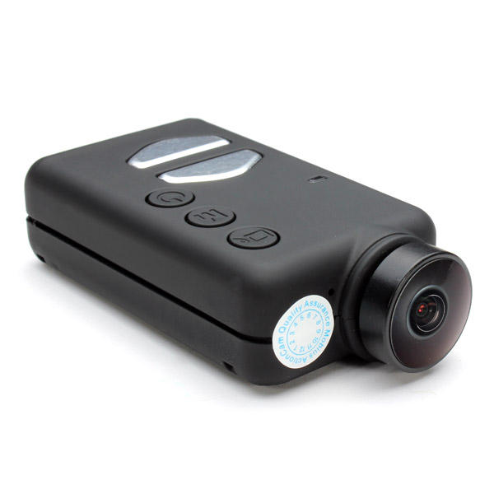
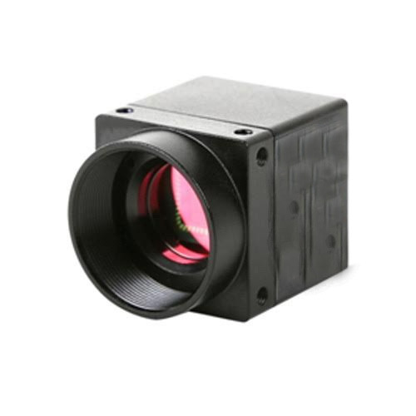
II. Image Analysis: Image Collection
Objectives:
Low power
Lightweight
Small
High framerate
High resolution
Cheap
Constraints:
No motion blur
USB
Evaluation Criteria:
Cost
Framerate
Resolution
Weight
Webcams
Microsoft Webcam
Action Cameras
Mobius Mini Action Camera
Machine Vision Cameras
Onix Vision Camera
Notes:
Objectives not requirements

Slide 9
II. Image Analysis: Image Collection
Notes:
Watch sig figs not to be petty ;)
Get with SE for score evaluation criteria

Slide 10
II. Image Analysis: Classification
Objectives
Accurate
Efficient
Easy to Develop
Constraints
Image Classification
Detect Location
Evaluation Criteria
Time to Develop
Accuracy
Time Complexity
Space Complexity
Build our own R-CNN
Terrible accuracy
Very slow
Will not finish
Keras
Terrible accuracy
Very slow
Might finish
YOLO
High accuracy
Easy to implement
Already trained
Very fast
Notes:
Great slide

Slide 11
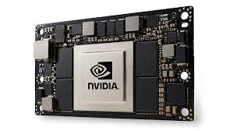
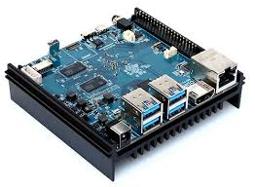

II. Image Analysis:
High Level Implementation
Use Odroid
Send to Ground Station
On-Board GPU
Cheap
Very slow
Already has a high workload
Cheap
Slow
Low bandwidth
Unreliable
Very fast
Real time analysis
More power and weight
Expensive
Odroid Computer
MSI Predator Laptop
nvidia Jetson TX2
Notes:
Square saying this is what we are selecting or place it at the end
Add plus or minus instead of bullets

Slide 12
II. Image Analysis:
On-Board GPU
Notes:
Slide after this we need a subsystem slide transition to radiation.

Slide 13
Design Concepts
Route Reconnaissance Swarming Behavior
Image Analysis
Radiation Detection Swarming Behavior
Radiation Detectors
Quick-Launcher Design
Notes:
- Add intro. Slides in between each, just like the repeating agendas
- ALL OF THESE SLIDES NEED TO BE RE-ORDERERD AND RE-NUMBERED

Slide 14
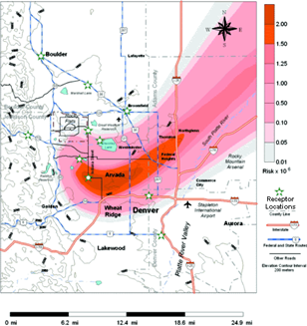
III. Radiation Detection: Mission Considerations
Our goal for this sub-mission is to map out the edge of the plume and the line of highest concentration in the middle of the plume.
The edge of the plume = 3x natural dose
Nuclear Eng. Cadets considerations
Aspects of Plume
What detectors were going to be used
Detector measurements
Percentage of dose, count, spectroscopy
Edge of plume
https://en.wikipedia.org/wiki/Radioactive_contamination_from_the_Rocky_Flats_Plant
Point of highest concentration
Notes:
Note where stuff came from. Caption on picture.

Slide 15
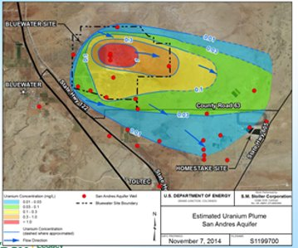
III. Radiation Detection: AY20 mission updates
Differences this year
mapping contour lines, or edges.
Utilization of Hermes Detectors
Smart swarming behavior
https://www.nrc.gov/docs/ML1825/ML18250A320.pdf
Notes:
Drop "unkown"
Focus on adaptive swarm and spectroscopy

Slide 16
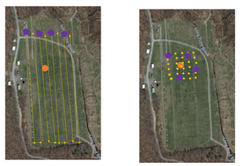
III. Radiation Detection: Swarming Behavior Initial Considerations
2019 Swarm Behavior –­­­­­­­­­­­­­­­­­­­­­
Broken up into 2 different phases
Phase 1:
Initial pass UAS self-distribute the available lanes
The data server populates the heat map
Continuously updates max radiation location.
Phase 2:
50x50m grid of survey points with 5m separation centered on max location
Greedy algorithm
Drone
Point Source
Phase 1 Phase 2
Depiction of Range 11: USMA Test Site
https://www.google.com/maps/@41.3834453,-73.9653432,15z
Notes:
Drop the part about starting in the middle and moving across.

Slide 17
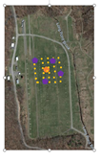
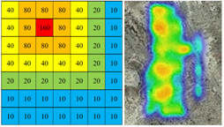
III. Radiation Detection: Swarming Behavior Initial Considerations
Savidge Swarm-
Smart swarm behavior
Swarming behavior communicates a new message of known data points used to update a system of predicted data points
Re-calculation of the ordering of data points.
Point Source
Drone
Savidge Prediction Behavior and Heat Map

Slide 18
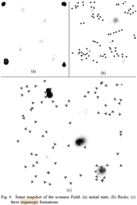
III. Radiation Detection: Swarming Behavior Initial Considerations
Combining Stigmergic and Flocking behaviors to perform target search-
drone behavior is structured into a three-layer logic
random fly (exploration) lowest priority layer
pheromone-based coordination (exploitation) middle layer
pheromone releasing behaviors highest priority architectural level.
concentrate of points of interest by leaving a pheromone that diffuses overtime.
This algorithm works like Savidge swarm with the added layer of flocking
doi: 10.1109/IISA.2015.7387990
Stigmergic and Flocking Behavior over time
Notes:
Look for a little movie or something put in here as a visual aid.

Slide 19
III. Radiation Detection: Initial Thoughts for Algorithm
Swarming Behavior | Pros | Cons
AY-19 Swarm | Initial Pass is an effective maneuver for initial data gathering | Phase 2 is not considered a smart swarm
Savidge Swarm | Utilizes a smart swarm for predictions | Currently implemented to focus on point sources
Flocking and Stigmergic Behavior | Utilizes a smart swarm system to adapt behavior | Flocking for our purposes could slow down effective data gathering

Slide 20
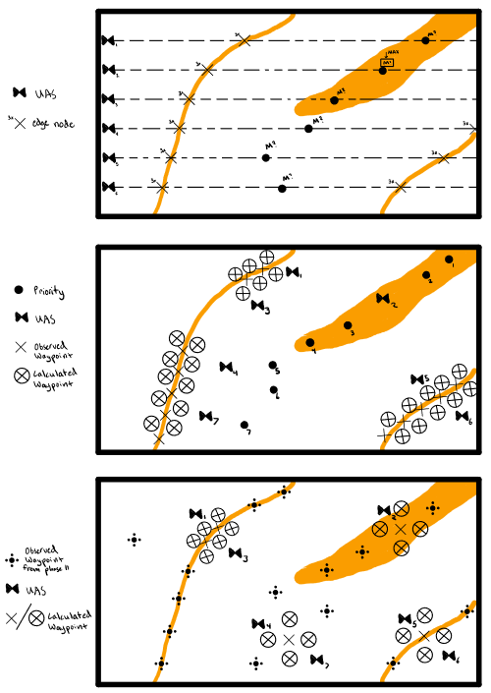
III. AY-20 Radiation Detection Algorithm
Use the initial pass portion of the 2019 Swarm Algorithm
After the initial pass, send to ground server all points where detector spike to 3x the natural dosage and points of max dosage recorded
Use Savidge Swarm on a portion of the drones (1-2) on max points for spectroscopy
Using Savidge swarm on the rest of the drones (1-15) to break up way points that are calculated by creating 4 waypoints around each 3x dose point
Drones calculate waypoint in “dead space” in between waypoints

Slide 21
1.Use the initial pass portion of the 2019 Swarm Algorithm
III. AY-20 Radiation Detection Algorithm: PHASE 1
AY-20 Radiation Detection Algorithm

Slide 22
III. AY-20 Radiation Detection Algorithm: PHASE 2
AY-20 Radiation Detection Algorithm
After the initial pass, send to ground server all points where detectors spike to 3x the natural dosage and points of max dosage recorded
Use Savidge Swarm on a portion of the drones (1-2) on max points for spectroscopy
Using Savidge swarm on the rest of the drones (1-15) to break up way points that are calculated by creating 4 waypoints around each 3x dose point (5 meters apart)

Slide 23
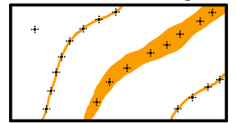
5. Drones calculate waypoint in “dead space” in between waypoints
III. AY-20 Radiation Detection Algorithm: PHASE 3
AY-20 Radiation Detection Algorithm

